Slide 1


SEO Flow Chart Strategy for Flinkit

Slide 2
SEO Strategy Plan for FlinkIt
HOME
Website Structure (blue print) of Flinkit on the basis of on page search engine optimization(SEO) with following blogs, products and categories pages.
ALL CATEGORIES
ABOUT
BLOGS
TERMS
LOGIN/SIGN UP

Slide 3
CATEGORIES
Type of Categories
Food Court
Foodgraind,oil and Masala
Bakery,Cake and Dairy
Beverages
Beauty and Hygiene
Types of Sub Categories
Burgers and Sandwiches
Aata,Flours and sooji
Bread and Buns
Cofee
Hair Care
Cake and pastry Delights
Daal and Pulses
Cake and Pastries
Energy Soft Drinks
Makup
Hot Baverages
Dry Fruits
Cookies,Rusk and Khari
Fruit juces and Drinks
Skin Care
Rolls Wraps
Edible oils and Ghee
Dairy
Health Drink,Supplement
Bath and Hadwash

Slide 4
CONTENT STRUCTURE CATEGORY PAGE
URL OPTIMIZATION: URL Should be simple and relevant keywords that shoppers may use to search for the Category.
flinkit.com/home/categories
Implement Effective Breadcrumbs:-Show the full path to the current page, starting from the
home page. Use a hyperlinked label for each level.
Example:-
Header Tag:-
H1 Tag- Buy Bakery Cakes and Dairy Online
H2 Tag- Bakery, Cakes & Dairy
H3 Tag- Bakery Snacks
H4 Tag-
Home Page
Categories Page
Bakery, Cakes & Dairy

Slide 5
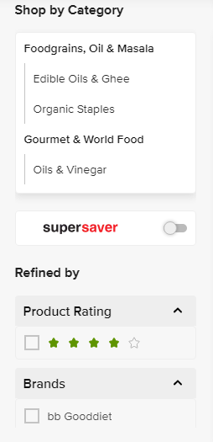
CONTENT STRUCTURE CATEGORY PAGE
H2 Tag
H3 Tag

Slide 6
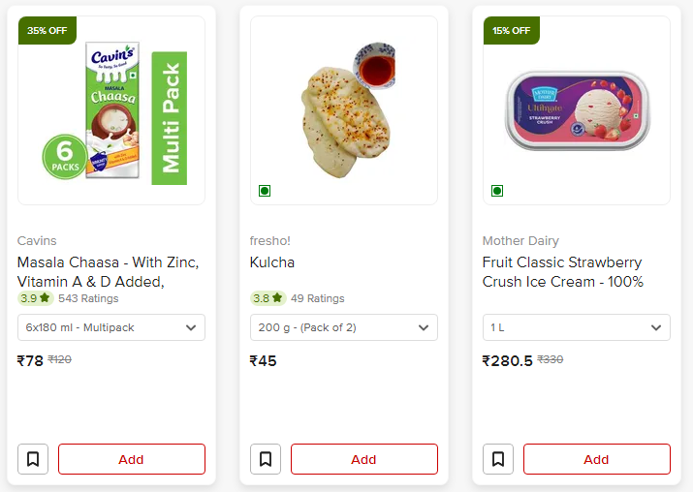
ALT:- Bakery, Cakes & Dairy
Title:- Category Bakery, Cakes & Dairy
Meta Description:- Discover freshly baked breads, delicious cakes, and premium dairy products. Perfect for every occasion – from breakfast to celebrations!
Optimized Image
With ALT,Title &
Description tag
H3

Slide 7
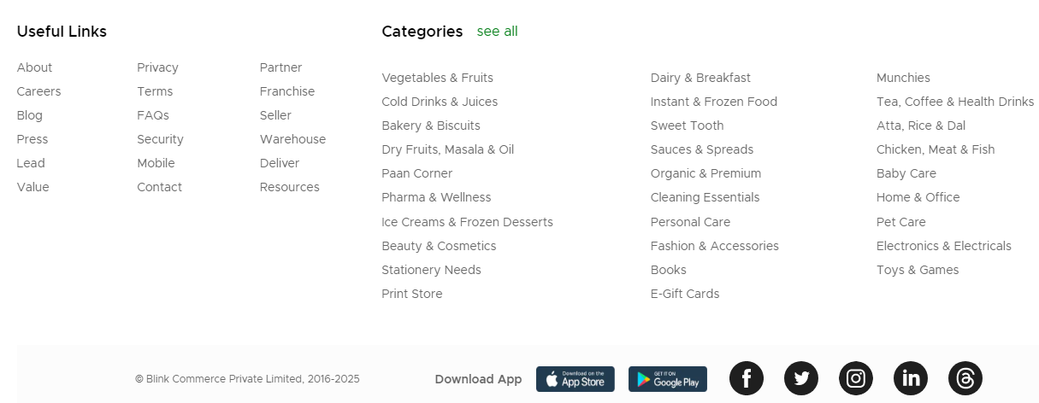
ALT:- Bakery, Cakes & Dairy
Title:- Category Bakery, Cakes & Dairy
Meta Description:- Discover freshly baked breads, delicious cakes, and premium dairy products. Perfect for every occasion – from breakfast to celebrations!
Page Footer:- Page footer use proper useful links social media links and app download links and etc.

Slide 8
CONTENT STRUCTURE PRODUCT PAGE
URL OPTIMIZATION: URL Should be simple and relevant keywords that shoppers may use to search for the product
flinkit.com/home/Bakery Cake and Dairy/Dairy/ Buttermilk & lassi
Implement Effective Breadcrumbs:-Show the full path to the current page, starting from the home page. Use a hyperlinked label for each level.
Home Page -> Category Bakery, Cake & Dairy->Sub Category Dairy->Product Buttermilk & lassi
Title tag: Have a clear Product page title tag. That will be appear in all sub category page in same category.
Dairy product Buttermilk & lassi
Header Tag
H1 Tag-Cavins Masala Chaasa - With Zinc, Vitamin A & D Added, Supports Immunity, 180 mli
H2 Tag-Cavins Masala Chaasa - With Zinc, Vitamin A & D Added, Supports Immunity<H2>

Slide 9
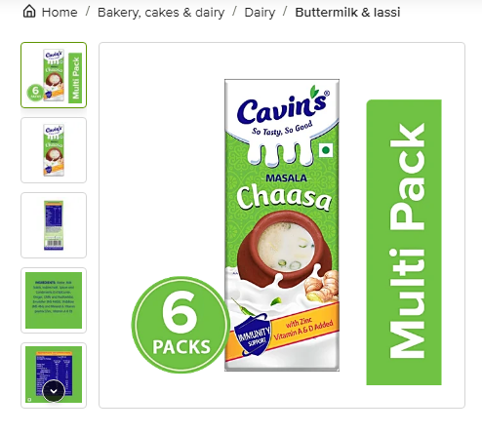
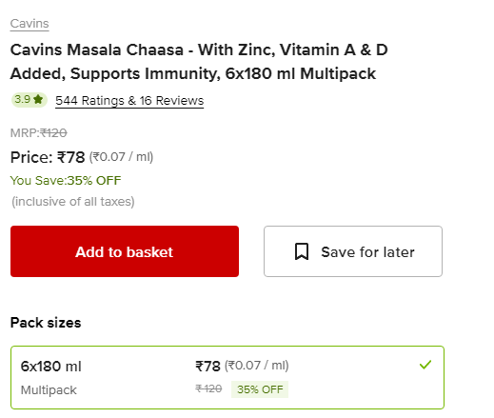

Optimized Image
With ALT,Title and Descriptions tag
H1 Tag
Reviews:-

Slide 10
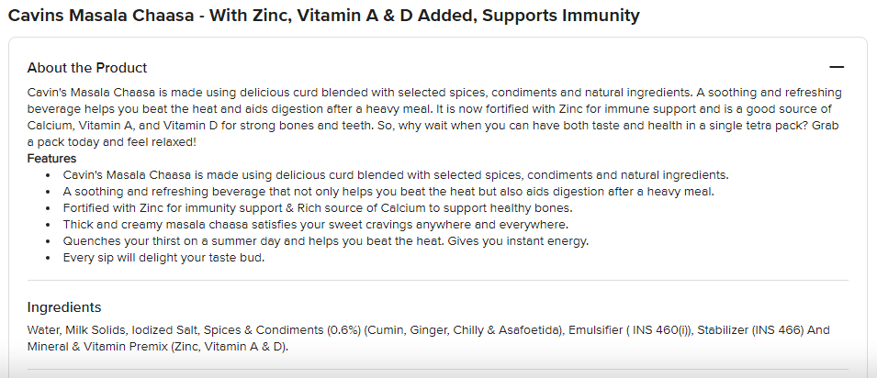
CONTENT STRUCTURE PRODUCT PAGE
H2 Tag
H3 Tag
H4 Tag

Slide 11
Product Image Optimization:- Be sure to use high-resolution images and include multiple images from different angles. And add close-up images to highlight important aspects of the product.
And complete image tag like ALT, Title, and meta description tag with primary keyword.
ALT Tag:- Buttermilk & lassi
Title Tag:- Dairy Product Buttermilk & lassi
Meta Description:- Discover the refreshing world of buttermilk and lassi, two delightful dairy products that not only tantalize your taste buds but also offer numerous health benefits. the cultural significance of these traditional drinks in our comprehensive guide to buttermilk and lassi.
Canonical tag:-Canonical tags to tell search engines which is the original page.
<link rel="canonical“ href=“https://www.flinkit.com/home/category/subcategory/buttermilk_lassi.html"/>

Slide 12
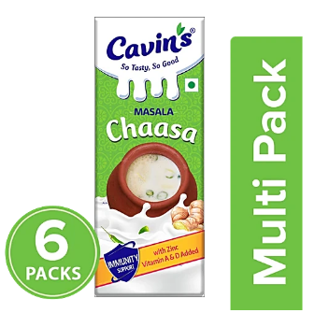
UI & UX :- Unique product images for each variant. This improves user experience by showing what your the variant looks like and also creates additional content that can be indexed by search engines.
Avoid duplicating content between variants. Only the truly unique details, like the variant name and images, should differ.
Include essential elements like pricing and reviews
Most shoppers look for information like pricing, availability, star ratings, and reviews. These are essential elements that guide their decision. Without them, it’s easy for users to bounce which hurts SEO.

Slide 13
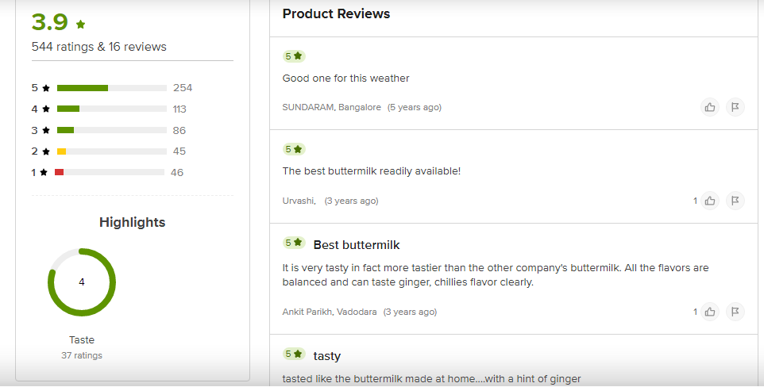
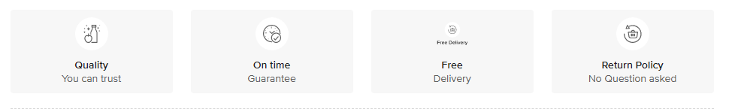

Slide 14
Why Choose Flinkit ?

Slide 15
CONTENT STRUCTURE BLOG PAGE
Category:- Immunity Boosters Fruits
Topic:- Summer Healthy fruits.
Content Structure for blog page
Title:- Top Refreshing and Healthy Fruits to Enjoy This Summer.
Note:- A catchy title that includes your target keyword and entices readers and length should be 55-65 characters.
Image Optimization:- Unique optimized images for each variant. This improves user experience
Image ALT tag:- Immunity Boosters, citrus fruits
Image Title:- Summer goodness of juicy citrus fruits
Meta Description:-Boost your immune system naturally with citrus fruits! Packed with vitamin C, antioxidants, and essential nutrients, these vibrant fruits like oranges, lemons, grapefruits, and limes are perfect for enhancing your health. Discover the incredible benefits of citrus fruits, delicious recipes to incorporate them into your diet, and tips for maximizing their immunity-boosting properties. Stay healthy and vibrant with nature's refreshing immune boosters!

Slide 16
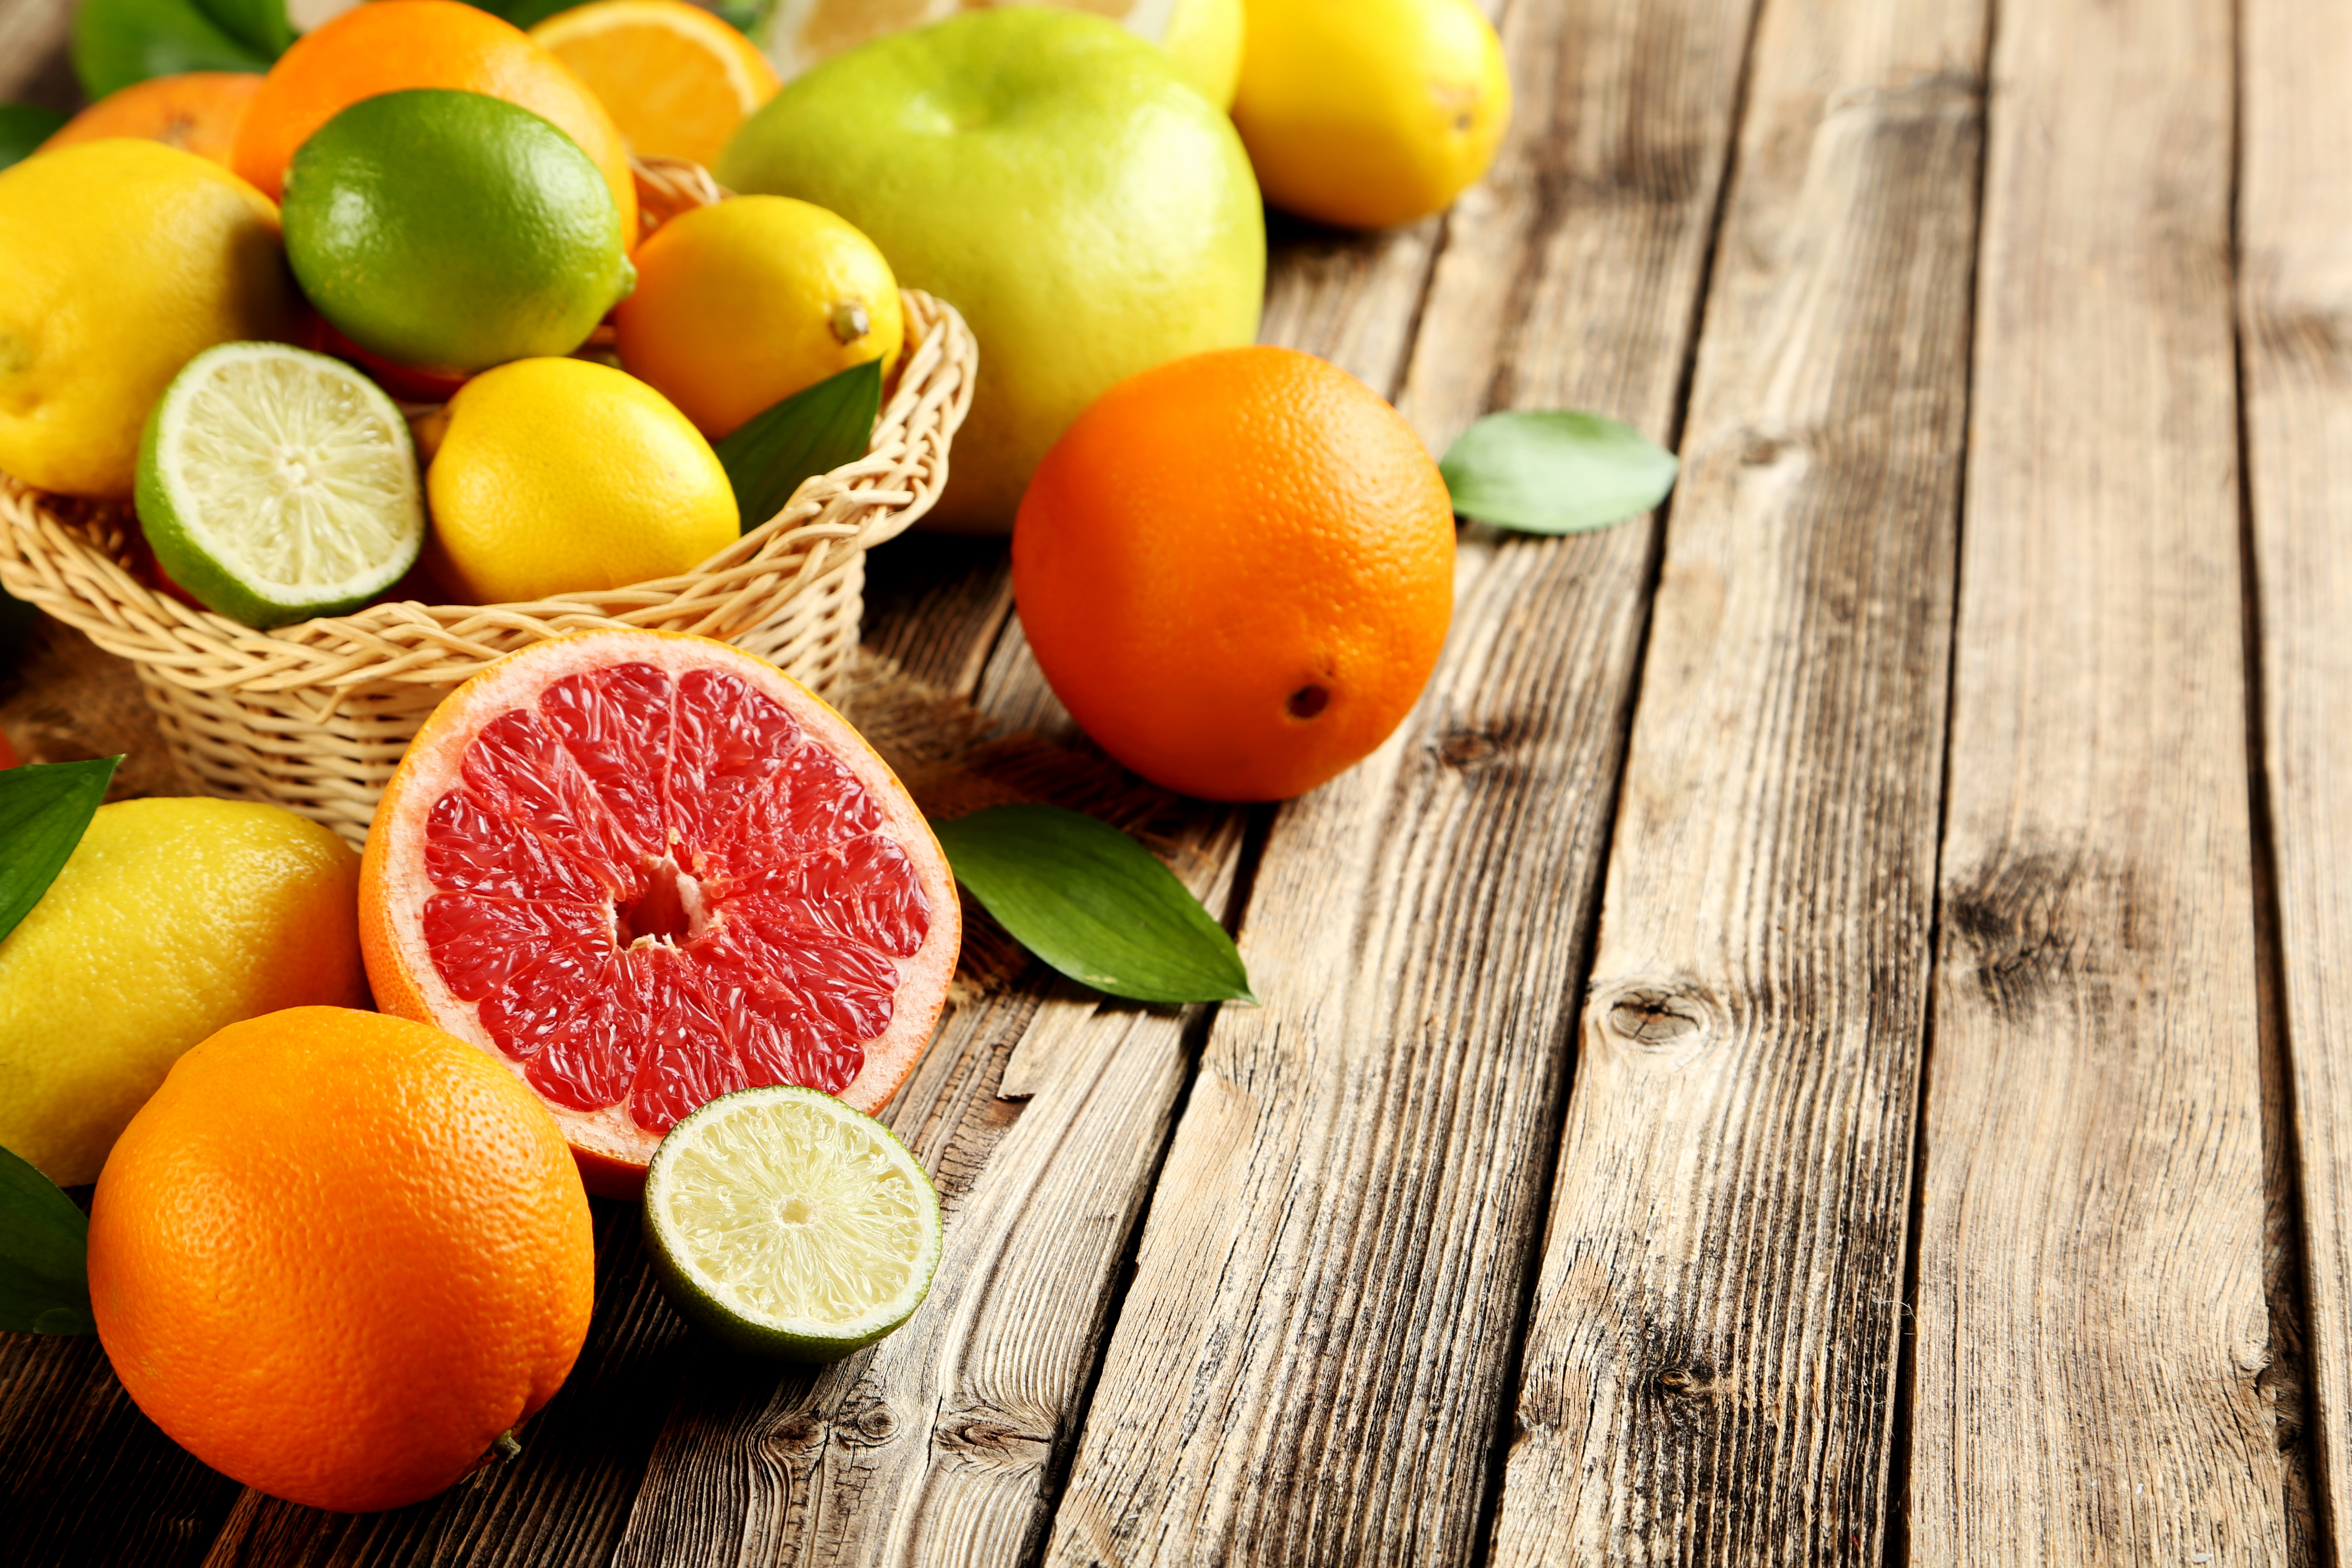
Introduction: As the sun blazes and temperatures soar, nature offers us a colorful, tangy gift: citrus fruits. Not only are they incredibly refreshing, but they’re also loaded with powerful nutrients that help bolster our immune systems. In a season when hydration and health go hand in hand, citrus fruits like oranges, lemons, limes, and grapefruits truly shine.

Slide 17
Main Body Content:
Note:- include H2,H3 and H4 header tag
Citrus Fruits: Nature’s Vitamin C Powerhouses H2 Tag
One of the most talked-about nutrients for immune health is Vitamin C, and citrus fruits are packed with it. This essential vitamin plays a crucial role in: Stimulating the production of white blood cells
Enhancing the function of skin as a barrier against pathogens Acting as a potent antioxidant, protecting against free radical damage Whether it’s a chilled glass of lemonade or a slice of grapefruit with breakfast, adding citrus to your daily routine can provide a much-needed immunity boost.
Hydration and Electrolytes: Beating the Summer Heat
Beyond immunity, citrus fruits help keep us hydrated — an essential benefit during hot summer days. Oranges and limes are high in water content and naturally rich in electrolytes like potassium, helping to maintain fluid balance and prevent dehydration.
Try infusing your water with slices of lemon, mint, and cucumber for a hydrating twist that supports digestion and cools you down. H4 Tag
Fighting Inflammation and Promoting Healing
Citrus fruits also contain other immune-supporting compounds such as flavonoids, including hesperidin and quercetin, which have anti-inflammatory and antiviral properties. These nutrients not only strengthen your immune response but also promote faster healing and better overall wellness.

Slide 18
A Burst of Energy and Natural Sweetness
What’s summer without a pop of bright, tangy flavor? Citrus fruits offer a naturally sweet and sour taste that’s perfect for energizing your day. Their high fiber content also helps regulate blood sugar levels and supports digestive health.
Add orange wedges to salads, squeeze fresh lime over grilled veggies, or enjoy a grapefruit bowl with a drizzle of honey — the options are endless and delicious.
Quick Tips to Enjoy Citrus in Summer: H2 Tag
Citrus Smoothie: Blend orange, banana, and a hint of ginger for a zesty immune-boosting smoothie.
Citrus Popsicles: Freeze lemon juice, orange juice, and a bit of honey for a healthy frozen treat.
Citrus Marinade: Use lemon and lime juice in marinades for fish or chicken — both refreshing and flavorful.
Conclusion: H2 Tag
Incorporating citrus fruits into your summer diet is a delicious way to stay cool, energized, and protected from seasonal bugs. Their juicy tang and immune-enhancing properties make them a must-have for anyone looking to thrive in the heat.
So the next time you're basking in the summer sun, reach for a citrusy snack — your taste buds and your immune system will thank you!

Slide 19

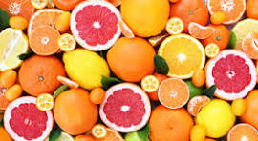

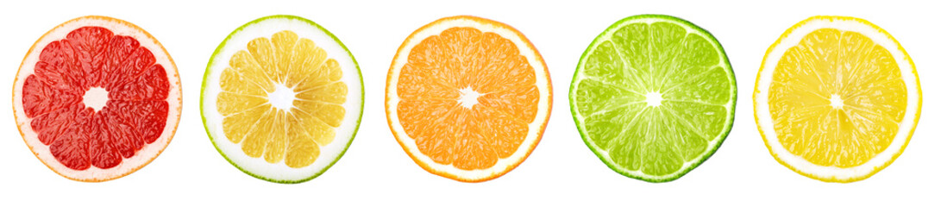

Slide 20
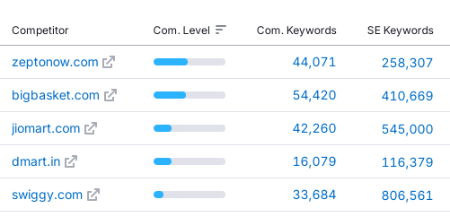
Competitive Analysis

Slide 21
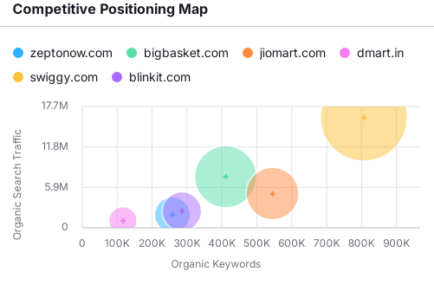
Competitive Analysis

Slide 22
Competitive Analysis
Key Factor | Competitor | Analysis Keyword Gap Volume Traffic KD
Keyword Gap Strengths and weaknesses | https://www.bigbasket.com/ | grocery store 450K 58.5K 83 stationery shop near me 368K 47K 59 Grocery 90.5K 42.5K 74
Keyword Gap Strengths and weaknesses | https://swiggy.com/ | restaurants near me Restaurants hd hub
Keyword Gap Strengths and weaknesses | https://blinkit.com | india map Decathlon Coffee

Slide 23
Keyword Research-Category page
Keywords | Avg.Search/m | Completion
cakes near me | 10K – 100K | High
bakery box | 10K – 100K | Low
bread | 1K – 10K | Low
bakery website | 1K – 10K | Low
wedding cake designs | 100 – 1K | Medium
bakery box | 100 – 1K | Low
best bakery near me | 10K – 100K | Low
pastries near me | 10K – 100K | Low

Slide 24
Keyword Research- Product page
Keywords | Avg.Search/m | Completion
Masala Chaasa | 10 – 100 | Low
buttermilk near me | 1K – 10K | Low
dried buttermilk | 100 – 1K | Low
buttermilk for sale | 10 – 100 | Medium
real buttermilk | 10 – 100 | Low
cavins chaasa | 10 – 100 | Low
organic buttermilk | 10 – 100 | High
buttermilk cost | 100 – 1K | Medium

Slide 25
(1) Url Optimization (2) Meta tag meta description (3) Header Tag (3) Image optimization ALT, title and description (4) Interlink and external link (5) Content quality (6) Keyword density (7) Site Speed
On-page Elements

